Slide 1
Chateau Beaumont
Year 6 Residential Trip
20th – 24th May 2019
Welcome All! Please
take a seat.
Students welcome to listen quietly.

Slide 2
Staff
Mrs Theresa Bryan
Miss Naomi Creese
Mr Joe Miley
Mr Matthew Mills
Group Leader:
Mrs Clare Bailey
Staff
Purpose
Itinerary
Accommodation
Organisation
Packing list
Pocket money
Contacts
Questions
Notes:
Staff going
Ratios (1:10 max)

Slide 3
Purpose
Why we offer school trips
&
Expectations
Staff
Purpose
Itinerary
Accommodation
Organisation
Packing list
Pocket money
Contacts
Questions
Notes:
Steve:
Not a holiday – taking the learning outside the classroom
Behaviour is obviously a priority as this could impact on the safety and enjoyment of the group.
Serious breeches in behaviour – parents will be contacted. To date, we have been fortunate enough not to need to do this, and we hope it continues.
It is hard work for all, but it is also great fun. The staff will ensure that all the pupils enjoy themselves. It’s been our experience that the pupils enjoy themselves so much, that although they are really excited when they return, they usually want to get straight back on the coach!
The safety of the whole group is a priority and Mrs Little and Miss Hudemann went on a Risk Assessment trip to make themselves familiar with the locations. You can be sure that we know where the pupils are at all times! They also need to do their bit, however, and we will talk about various ways this is achieved with the pupils.
Knowing that we have all these systems in place ensures that the pupils are happy.

Slide 4
Itinerary
Monday:
3:15 Children meet in the school hall
3:45 Prompt departure for Portsmouth
8:15 Ferry sails to Caen Breakfast and Lunch on the ferry
18:00 Arrive at Chateau Beaumont
18:30 Evening meal
Followed by Unpacking etc.
Treasure Hunt
Staff
Purpose
Itinerary
Accommodation
Organisation
Packing list
Pocket money
Contacts
Questions

Slide 5
Itinerary
Tuesday:
7:45 Breakfast
AM On site activities with qualified instructors:
13:30 Lunch on site
PM Visit to picturesque medieval Sainte Suzanne
18:30 Evening meal
Evening Activity
Staff
Purpose
Itinerary
Accommodation
Organisation
Packing list
Pocket money
Contacts
Questions

Slide 6
Itinerary
Wednesday:
7:45 Breakfast
AM St Hilaire Market
Packed Lunch at St Hilaire
PM Le Mont St Michel
18:30 Evening meal
French Quiz and Fancy Dress
Staff
Purpose
Itinerary
Accommodation
Organisation
Packing list
Pocket money
Contacts
Questions

Slide 7
Itinerary
Thursday:
7:45 Breakfast
AM Goats Cheese Farm
Hypermarket at Ernee
13:30 Lunch on site
PM On site activities with qualified instructors:
18:30 Evening meal
Talent Show and Disco
Staff
Purpose
Itinerary
Accommodation
Organisation
Packing list
Pocket money
Contacts
Questions

Slide 8
Itinerary
Friday:
7:45 Breakfast and collection of packed lunches
AM Visit: Arromanches
360 cinema
Landing Beaches
Packed Lunch in Arromanches
16:30 Check-in for ferry
00:00 Approximate arrival time back at the school.
Keep an eye on Twitter for travel updates.
Staff
Purpose
Itinerary
Accommodation
Organisation
Packing list
Pocket money
Contacts
Questions

Slide 9
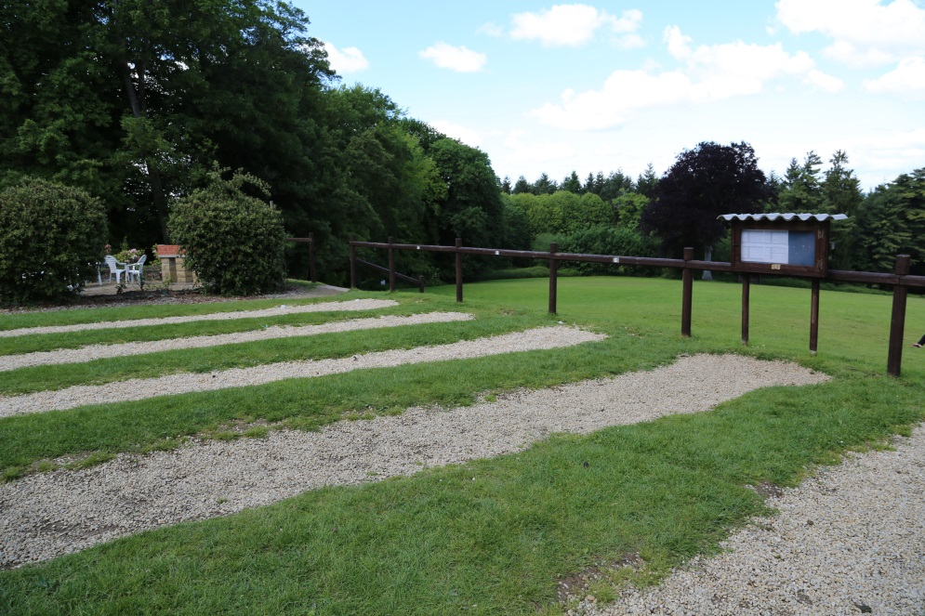
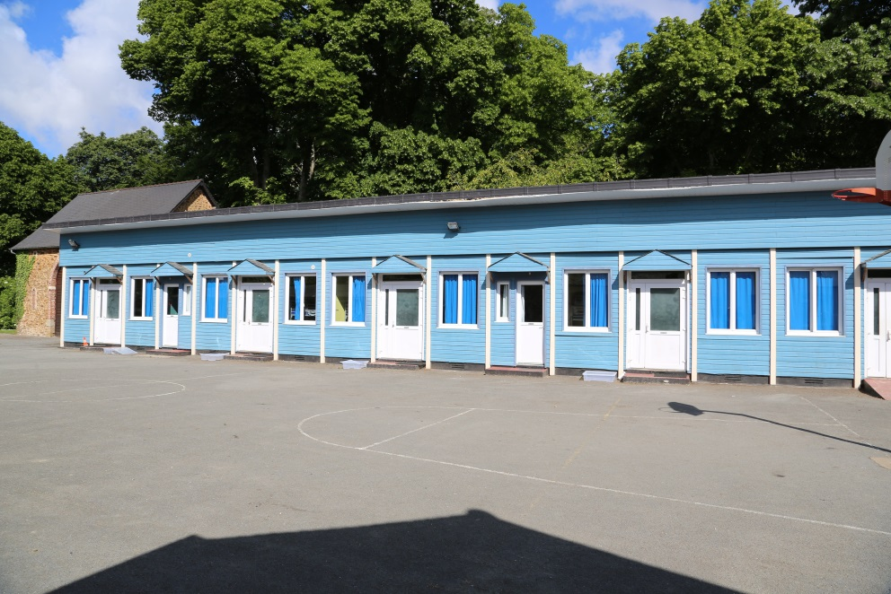
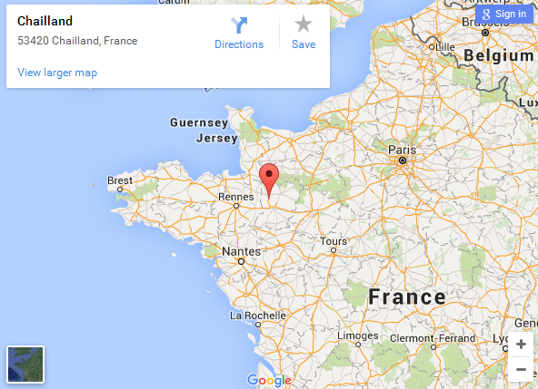
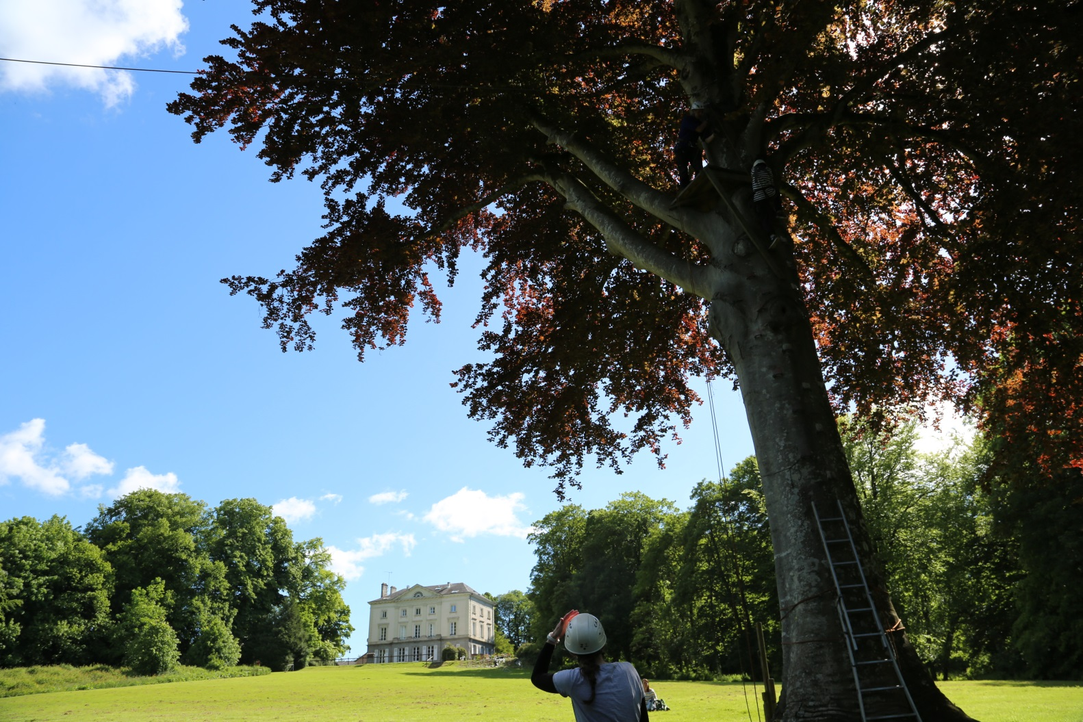
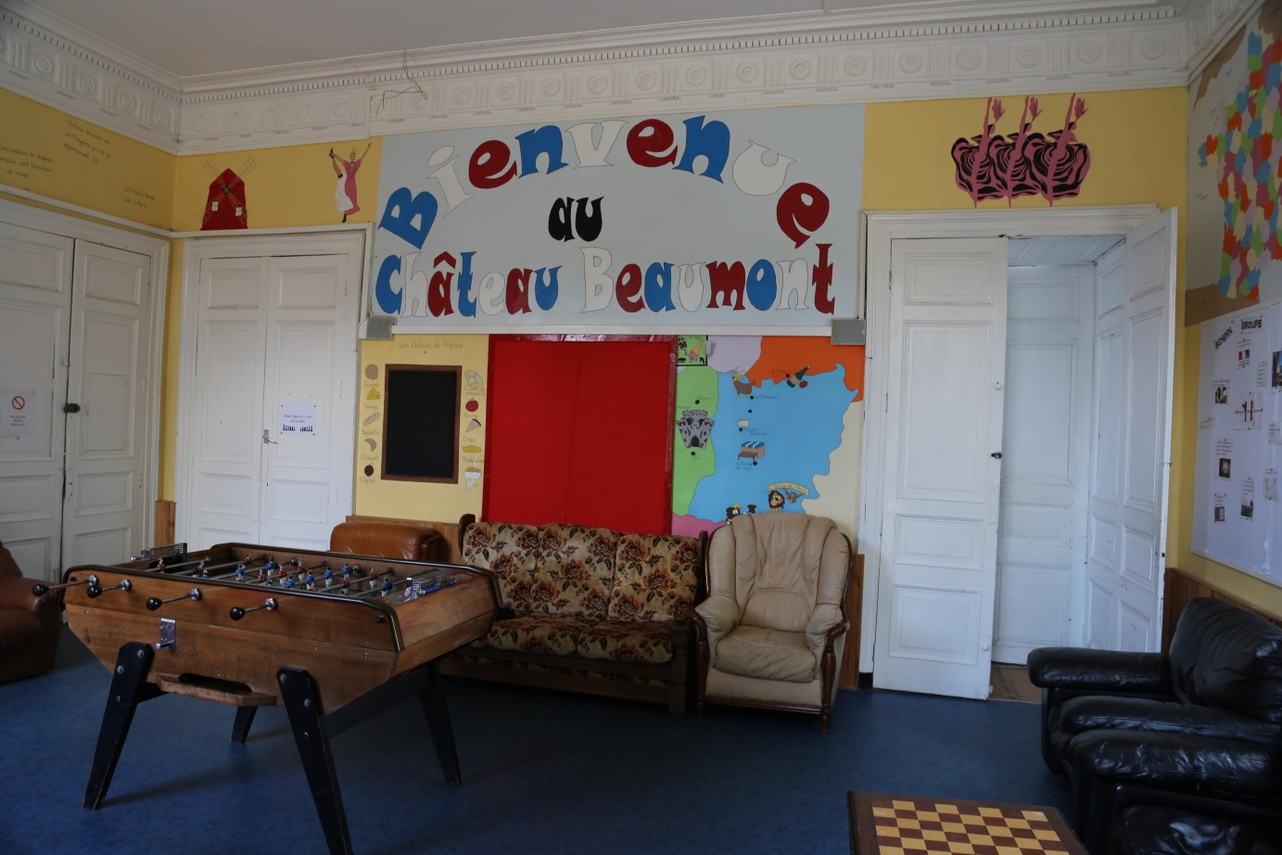
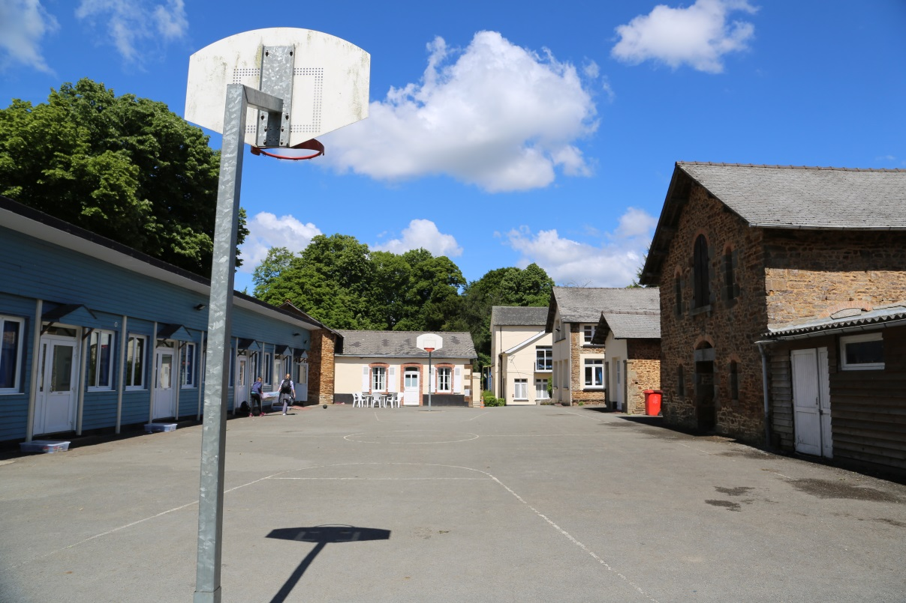
Accommodation
Chateau Beaumont
Staff
Purpose
Itinerary
Accommodation
Organisation
Packing list
Pocket money
Contacts
Questions

Slide 10
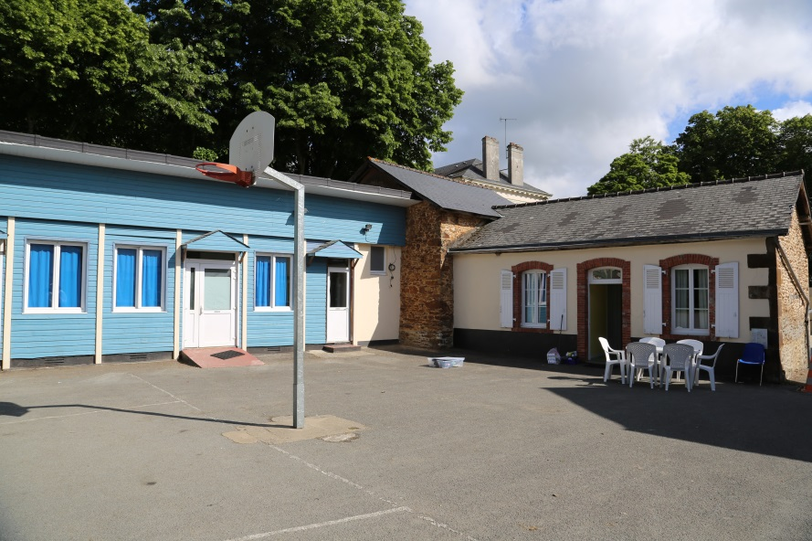
Accommodation
- pupils will be in rooms of 6 to 12 (boys and girls separated)
- rooms will be overseen by staff
- points will be given for tidy rooms (with a prize at the end of the week)
- bed time will be around 9:30, lights out at 10:00
- medication will be administered by one member of staff each day with a record being kept
- personal hygiene will be emphasised
Staff
Purpose
Itinerary
Accommodation
Organisation
Packing list
Pocket money
Contacts
Questions
Notes:
Fantastic location – 18th Century Stately home.
Bedrooms
Personal Hygiene
Room Points
Meals
Bed times
Pocket Money
Medicines

Slide 11
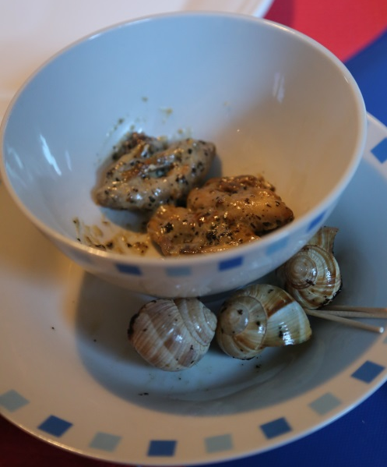
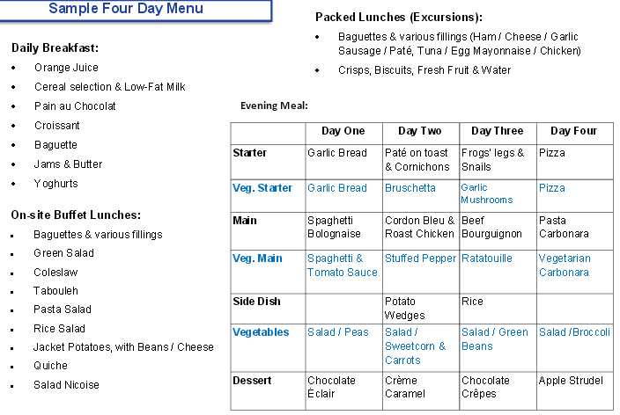
Accommodation
Meals include:
Dietary requirements will be taken into account with ALL meals; allergies are catered for.
Staff
Purpose
Itinerary
Accommodation
Organisation
Packing list
Pocket money
Contacts
Questions
Notes:
Fantastic location – 18th Century Stately home.
Bedrooms
Personal Hygiene
Room Points
Meals
Bed times
Pocket Money
Medicines

Slide 12
Organisation
- pupils will be in small groups for activities, overseen by an adult plus centre staff
- pupils will be given a school hat for the trip
- a chance to develop independence and learning to deal with being away from home
- brief outlook on the next day each evening
- pupils will have to pack their own day bags
-a reminder label will be attached to their day bags
- no ‘letters from home’, please- Nice idea but can unsettle the children.
Staff
Purpose
Itinerary
Accommodation
Organisation
Packing list
Pocket money
Contacts
Questions
Notes:
School journey is a chance for the pupils to show independence and a high level of personal organisation. We will expect them to be organised enough to be in the right place at the right time, with the right equipment and clothing. Even though our ratio is quite high, we can’t be expected to continually keep asking and reminding them what they should be doing.
Time is taken each evening to ensure that the pupils know what the following day will be about, and what they might need. It’s all about empowering the pupils to take ownership of their learning.
The first time they need to be really organised is on the Sunday morning:
Medicines
Pocket Money
Packed lunch
Rucksack
Notebook etc
Clothing – had a list already – NO school uniform (winter) – school hoodies - some casual… waterproofs etc. NOT brand new walking boots.
Cameras
NO OTHER ELECTRONIC ITEMS

Slide 13
Organisation
Please, keep in mind that your child will be responsible for carrying their own luggage.
On the day of departure:
- Please send your child to the hall with their day bag.
- Luggage is to be left on Lower School playground to be loaded.
- If it rains, please leave bags in the foyer.
- Please administer travel sickness medication or hand out travel sickness wrist bands at home, if needed.
- Please hand in last minute medication as well as travel sickness medication for the return journey (labelled!) to Miss Creese (with a signed permission letter allowing us to administer the medication!).
- If you have not done so already, please hand in your Passport and EHIC card to Mrs Bailey.
The children will need a day bag with:
- a packed breakfast and snack
- a drink
- a magazine/ book/ puzzle book
- a rain coat and sun-cream
Staff
Purpose
Itinerary
Accommodation
Organisation
Packing list
Pocket money
Contacts
Questions

Slide 14
Packing list
Please, can all items, clothes and towels be labelled so we can identify owners of left items easily!
Clothing:
- appropriate for warm weather, as well as rainy days
- a change of OLD clothes for some activities (will get dirty)
- swimwear (swimming costumes only)
- children may bring special (but appropriate) clothes for the disco
- a costume for French Night
- long-sleeved tops and jeans (important for activities!)
Other items of clothing needed include:
trousers, shorts, t-shirts,, jumpers/hoodies/fleeces, socks, trainers, raincoat, underwear, nightwear, indoor shoes
Personal items:
- day bag (a rucksack is ideal)
- purse with pocket money
- puzzle book/ book/ magazine
- 2 towels (one for daily hygiene, one for swimming)
- wash bag with all personal hygiene items, including brush/ comb
- refillable drink bottle (1 litre is ideal)
- tissues
- sun cream
- necessary medication (labelled with permission letter)
- if your child wishes: digital/ disposable camera (labelled)
NO PHONES OR OTHER ELECTRONIC DEVICES, PLEASE!
Staff
Purpose
Itinerary
Accommodation
Organisation
Packing list
Pocket money
Contacts
Questions

Slide 15
Pocket money
We suggest the following maximum amount of pocket money:
- 50 € (for the market, etc)
It would help if the money was in small denominations from the start.
The children will be responsible for looking after their own money.
Staff
Purpose
Itinerary
Accommodation
Organisation
Packing list
Pocket money
Contacts
Questions

Slide 16
COntacts
Updates
Daily updates will be made on Twitter (generally in the evenings). Have a look to find out what we have been up to!
Emergencies
All pupils will carry a label with emergency contacts in French on their bags at all times. Staff have been provided with local emergency numbers.
In an emergency we will contact you at the earliest opportunity on your home number or the number provided on the consent form.
If you need to contact your child (only in an absolute emergency), please phone the school office. Mrs Cook and Mr Mills have all the contact numbers for staff on the trip and will be able to get in touch immediately.
An out-of-hours number is provided on the parent leaflet.
Staff
Purpose
Itinerary
Accommodation
Organisation
Packing list
Pocket money
Contacts
Questions
Notes:
Emergency contact – phone the School who will have mine and your phone numbers

Slide 17
Questions
Are there any questions?
Staff
Purpose
Itinerary
Accommodation
Organisation
Packing list
Pocket money
Contacts
Questions

Slide 18
Merci Beaucoup
Don’t forget to take your copy of the parent leaflet!

